Slide 1
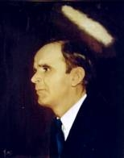

AS THE DEER PANTETH FOR THE WATERS
As the deer panteth for the waters
So my soul longeth after thee
You alone are my heart desire
And I long to worship thee

Slide 2
CHORUS
You alone are my strength and my shield
To you alone let my spirit yield
You alone are my heart desire,
And I long to worship thee.

Slide 3
You are my friend, and you are my brother
Even though you are my King
I want you more than any other
So much more than anything.

